Slide 1



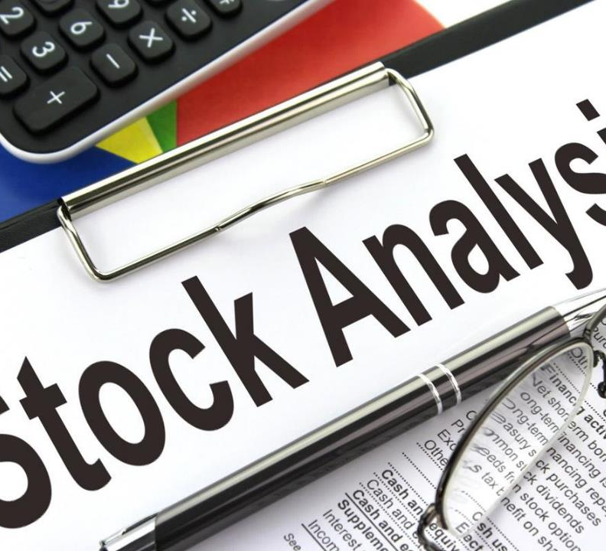

Apple stock project
Allswell Sam Obeng
Analysis of Apple's Stock Prices from 1990 to 2024
20th October 2024

Slide 2
Introduction & objectives
Overview: The Apple Stocks Project performs analysis on Apple's Stock prices from 1990 to 2024, and derives some insights concerning its rate of volatility, trend, and market performance. The dataset used for this analysis was obtained from Kaggle, and It entails daily stock prices for Apple Inc. (AAPL), including open, high, low, close prices and volume (Singh, 2024) from 1990 to 2024.
Objectives:
Analyze trends in Apple’s stock price.
Evaluate daily returns and volatility.
Identify key insights from trading volume and stock movements
Research Questions:
How has Apple’s stock price evolved over time?
What is the typical range of daily returns?
Are there any correlations between trading volume and stock price movement?

Slide 3
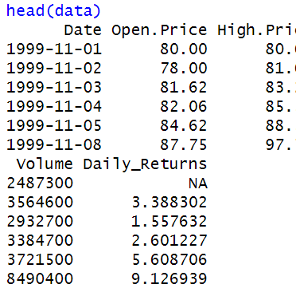

Data cleaning and preparation
Summary of Cleaning Steps:
Handled missing values (e.g., dropped rows with NA).
Converted Date variable to Date format.
Calculated Daily Returns as a new variable.

Slide 4
Descriptive Statistics
The mean daily return of 0.08% indicates that, on average, Apple's stock experiences a slight positive growth in price each day. Though small, this positive average suggests that, over time, Apple's stock tends to gain value.
The standard deviation of 2.97% for daily returns shows the variability in the stock's daily performance. This means that while the average daily return is 0.08%, the actual return on any given day could vary by about 2.97% above or below that mean.
 | Open Price | High Price | Low Price | Close price | Volume | Daily Returns(%)
Minimum | 12.99 | 13.19 | 12.72 | 13.12 | 702500 | -85.49
1st Quartile | 77.52 | 79.29 | 76.22 | 77.61 | 12045675 | -1.00
Median | 138.60 | 140.18 | 136.44 | 138.69 | 24548739 | 0.09
Mean | 174.05 | 175.98 | 172.02 | 174.06 | 33108011 | 0.08
3rd Quartile | 200.84 | 202.94 | 198.75 | 200.92 | 44337979 | 1.28
Maximum | 702.41 | 705.07 | 699.57 | 702.10 | 332607163 | 13.90
SD |  |  |  |  | 30622623 | 2.97

Slide 5
Descriptive Statistics
Mean Trading Volume: 33,108,011 shares
The mean trading volume of 33.1 million shares indicates that, on average, this many shares of Apple stock are traded each day. This reflects a high level of investor activity and interest in Apple stock, showing that it is a highly liquid stock, where shares are frequently bought and sold ( Fama, 1970).
Standard Deviation for Trading Volume: 30,622,623 shares
The standard deviation of 30.6 million shares shows significant variability in daily trading volume. This means that on some days, the number of traded shares can deviate by as much as 30.6 million from the average. A high standard deviation suggests that Apple's stock sees dramatic fluctuations in trading volume, with some days seeing unusually high trading, often around major events like earnings reports or product launches ( Sharpe et al., 1999)

Slide 6
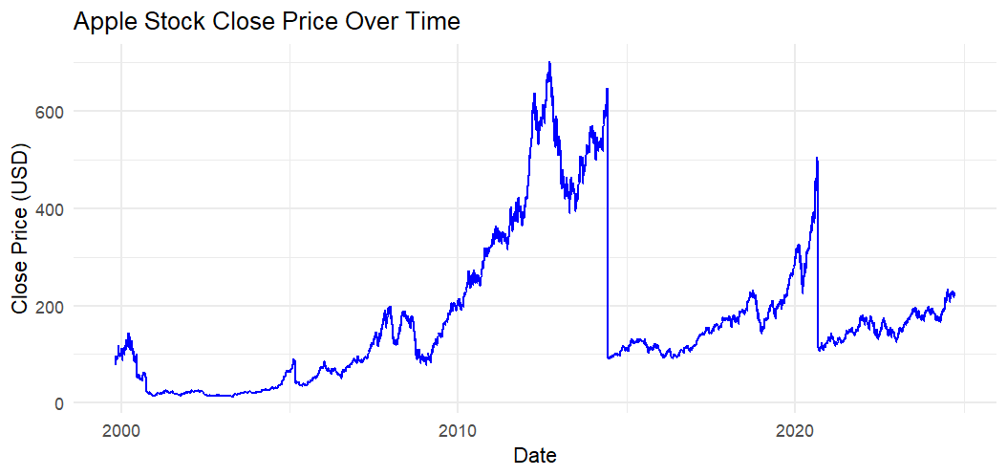
Apple stock price over time
The chart tracks Apple's closing stock price over several years.
There are noticeable spikes around 2012-2013, 2017, and 2020, likely corresponding to significant product releases or business growth (Bodie et al., 2021).
Recent trends show the price has been increasing steadily since 2020.

Slide 7
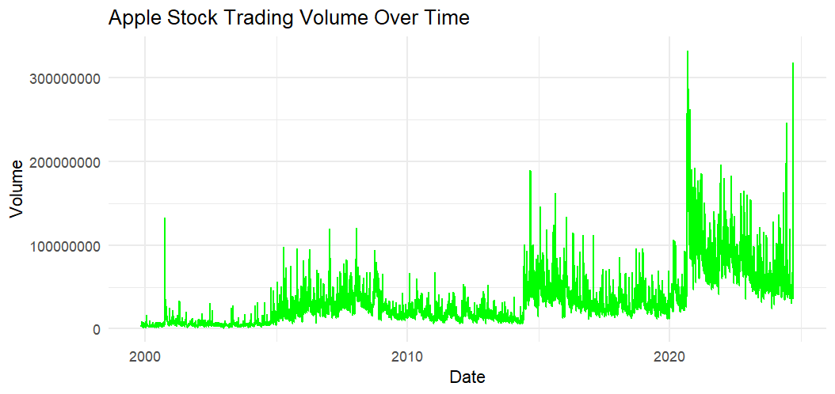
Trading Volume Over Time
This chart depicts the trading volume of Apple stock over time.
There is a clear increase in volume, especially post-2010, indicating growing investor interest or increased market activity.
Spikes in volume could correlate with important events such as earnings reports, product launches, or stock market fluctuations ( Fama, 1970).

Slide 8
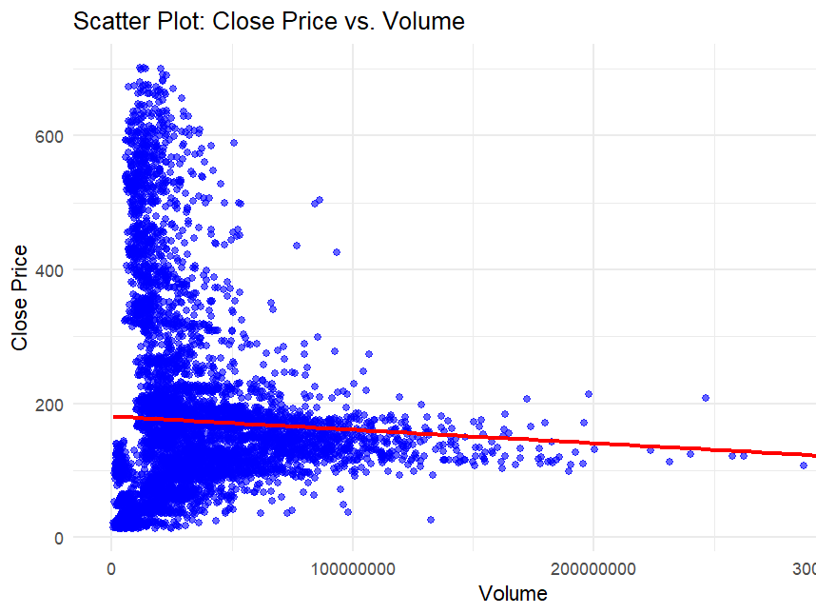
Correlation between close price and volume
The red line represents a linear regression fit, showing a slight negative slope. This indicates a weak negative correlation between trading volume and closing price, suggesting that higher prices are associated with slightly lower trading volumes. However, the trend is not very strong.
-0.041 is the correlation coefficient confirming the negatively weak correlation between Apple stock close price and its trading volume.
This suggests that factors other than just trading volume are influencing the stock price (Malkiel, 2019).

Slide 9
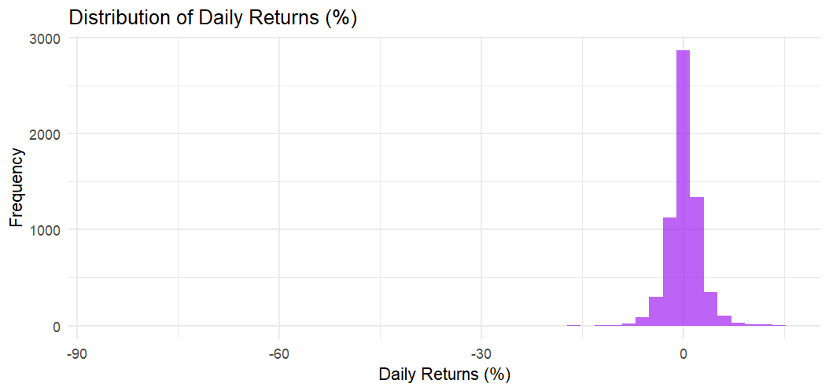
Distribution of Daily Returns (%)
This histogram shows how Apple stock's daily returns are distributed.
Most of the returns hover around 0%, with a sharp peak close to that value, indicating small daily changes are most common.
There are some outliers in both directions, representing occasional significant gains or losses.
The negative outliers might indicate major stock market downturns or specific company events that caused a sharp decline in stock value (Bodie et al., 2021)

Slide 10
Key insights from analysis
Consistent Long-Term Growth:
The mean daily return of 0.08% indicates steady long-term growth in Apple's stock price. Over time, the stock tends to appreciate, though daily changes are often small.
Significant Daily Volatility:
With a standard deviation of 2.97%, Apple's stock shows considerable daily volatility. Although the mean return is small, there are frequent fluctuations, with potential for both gains and losses.
The minimum return of -85.49% and maximum return of 13.90% highlight some extreme days, likely driven by market-wide events or company-specific developments (Bodie et al., 2021).
High Trading Volume:
Apple’s stock sees robust investor interest, with an average daily trading volume of 33.1 million shares. This high trading activity indicates strong liquidity and consistent market engagement (Fama, 1970).
Large Variations in Trading Volume:
The standard deviation of 30.6 million shares in trading volume shows that while trading is generally high, it can spike dramatically on certain days, likely in response to earnings reports, product launches, or macroeconomic factors (Sharpe et al., 1999).
Volume Spikes Align with Significant Events:
The maximum trading volume of 332.6 million shares indicates major trading spikes, often seen during critical events like product releases or financial announcements, when investor activity surges (Hull, 2017).
Weak Negative Correlation Between Price and Volume:
The correlation coefficient of -0.041 suggests a weak negative relationship between closing price and trading volume, meaning that higher prices may slightly correspond with lower trading volumes (Malkiel, 2019).

Slide 11
references
Singh, P. (2024). Apple stocks [Data set]. Kaggle. Link
Bodie, Z., Kane, A., & Marcus, A. J. (2021). Investments (12th ed.). McGraw-Hill Education.
Fama, E. F. (1970). Efficient capital markets: A review of theory and empirical work. The Journal of Finance, 25(2), 383–417. Link
Hull, J. C. (2017). Options, futures, and other derivatives (10th ed.). Pearson.
Sharpe, W. F., Alexander, G. J., & Bailey, J. V. (1999). Investments (6th ed.). Prentice Hall.
Malkiel, B. G. (2019). A random walk down Wall Street (12th ed.). W.W. Norton & Company.

Slide 12
Thank you

